Slide 1
Heavy Metals
Gillian Beauchamp, MD

Slide 2
Outline
Mercury
Arsenic
Lead

Slide 3
Mystery Case 1
38 year old male wood-worker/builder
4 months of numbness & tingling in fingers and toes
Now burning in sensation
Difficulty holding his tools but no other symptoms
His hands are very ‘worn’ from his job

Slide 4
Medical History
He lives in a home he built himself (10 years ago)
Water source: well water (Artesian well)
Fuel source: burning wood (left over from building sites)
2 beers per week, 1 pack cigarettes per day
No medications or allergies
No significant family history

Slide 5
Physical Exam
Decreased proprioception in hands and feet
Painful response to sharp stimulus on palms and soles
4/5 strength bilateral dorsiflexion at ankle joints and with wrist extension
Achilles reflexes markedly decreased
Patellar and biceps reflexes mildly decreased (1+)
No ataxia
Normal cranial nerves

Slide 6
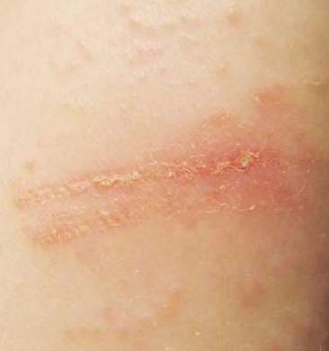
Skin Exam
http://www.slideshare.net/Telugudoctor
Notes:
Hyperkeratosis: ‘dew drops on a dusty road’

Slide 7
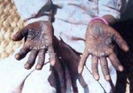
http://www.slideshare.net/Telugudoctor
Notes:
Irregularly shaped areas of hyperkeratotic plaques – same on patient’s torso (elevation about 4mm) + areas of dark hyperpigmentation with overlying areas of pallor.

Slide 8
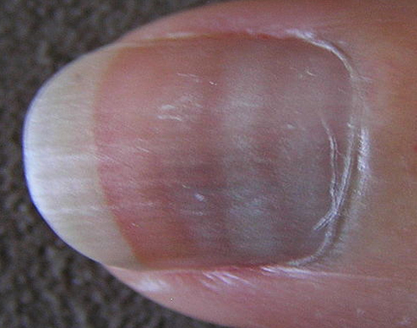
Skin
http://reference.medscape.com
Notes:
Mees Lines

Slide 9
Quiz
What is the differential diagnosis for this patient?
What tests would you like to order?

Slide 10
The Differential Diagnosis
Guillian Barre – primarily motor affected
Chronic alcoholism: peripheral neuropathy, macrocytic anemia, elevated LFTs
Thallium toxicity: painful peripheral neuropathy
Diabetes mellitus
Arsenic toxicity

Slide 11
Laboratory Evaluation
CBC
Metabolic profile with liver function tests
Electromyography and nerve conduction studies
Dermatologic assessment: skin biopsy
Urine arsenic concentration
  Spot urine specimens can be useful in the acute setting
  24 hour urine collection is ideal
  Normal is 50 ug/L
  Abnormal is 200 ug/L
  Ensure no seafood ingestion for 48 hours, then repeat test
Notes:
Volunteers eating lobster lunch had average urinary conc of 1300 ug/L four hours after lunch – pre-lunch concs were 30 ug/L – 48 hours later, concs returned to pre-test values.

Slide 12
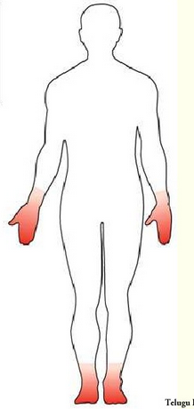
Summary of Mystery Case 1
Wood-worker & builder
“Stocking glove” neuropathy
Mild bilateral weakness: wrist and ankle joints
Decreased reflexes
Hyperpigmentation with overlying areas of pallor
Hyperkeratosis
Mees lines
http://www.slideshare.net/Telugudoctor
Notes:
Differential diagnosis for peripheral neuropathy: ***
Differential diagnosis for hyperkeratosis:
Differential diagnosis for Mees Lines:

Slide 13
Hemoglobin 9.0 g/dL (normal 13.5 – 17.5 g/dL)
Hematocrit 36% (normal 40 – 52%)
MCV 111 fL (normal 80-100 fL)
WBC 4.6 X 10³/mm³ (Normal 3.9 – 11.7 X 10³/mm³)
Differential: 10% eosinophils (normal 0-4%)
Mildly elevated liver function tests: AST 58 (normal 10 – 40 U/L), ALT 72 (normal 7 – 56 U/L)
Mildly elevated creatinine 1.4 mg/dL (normal 0.7 – 1.3 mg/dL)

Slide 14
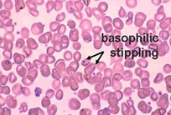
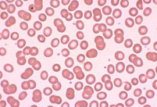
Peripheral Smear
www.atsdr.cdc.gov
Notes:
Basophilic stippling on peripheral smear (left slide) versus normal RBCs on right slide
Differential diagnosis for basophilic stippling: Arsenic, Lead
Basophilic stippling aka Punctate basophilia refers to an observation found when observing a blood smear in which erythrocytes display small dots at the periphery. These dots are the visualization of ribosomes and can often be found in the peripheral blood smear, even in some normal individuals.

Slide 15
Mystery Case 2: The Same Toxin!
A valve on a chemical tank blows off at 1:30 pm
A white cloudy gas is released – ‘garlic’ and ‘fishy’
Chemical plant: manufacture of semiconductor chips for cell phones
100 workers are evacuated from the area
The patients complain of feeling short of breath and nauseated – symptoms begin to worsen in the 2 hours following exposure
Notes:
Arsine gas release: Tulsa, OK 2001 Solkatronic Chemical Plant

Slide 16
Initial Complaints
Chills, malaise, lightheadedness
Headache
Nausea, vomiting and crampy abdominal pain
Blood in urine

Slide 17
Hospital Course
Most patients are discharged home after brief observation
Several patients are admitted with persistent generalized weakness and SOB
Hemolytic anemia with transient hypoxia
Hemolysis induced renal failure
Mild elevation of liver function tests
Treatment: IV fluid, bronchodilators, bicarbonate infusion and supplemental oxygen
Patients discharged within 24-48 hours

Slide 18
Quiz: What exposure do our patients have in common?
Wood-worker & builder
“Stocking glove” neuropathy
Mild bilateral weakness: wrist and ankle joints
Decreased reflexes
Hyperpigmentation with overlying areas of pallor
Hyperkeratosis
Mees lines
100 semiconductor industry workers exposed to a ‘white gas’
Headache, malaise, difficulty breathing, nausea, vomiting, abdominal cramps
Hemolytic anemia
Renal failure
Mild transaminitis

Slide 19
Arsenic: Background
Naturally occurring element
Distributed widely through earth’s crust and in groundwater
Organic arsenic: found in plants and animals = As + C + H
Inorganic arsenic: Arsenic in environment = As + O + Cl + S
By-product of smelting process for metal ores: Pb, Au, An, Co, Ni
Notes:
20th most common element in earth’s crust

Slide 20
Sources of Arsenic: Industrial
By-product of smelting process for metal ores: Pb, Au, Co, Ni
Purifying of industrial gases (removal of sulfur)
Electronics manufacturing
  Lasers
  Light-emiting diodes
  Photoelectric cells
  Semiconductor devices

Slide 21
Sources of Arsenic: Arsine Gas
Used as a dopant in production of semiconductors
Exposure may occur when arsine gas is generated while metals or crude ores containing arsenic impurities are treated with acid
May be accidentally released during manufacturing process or the transportation of the gas
Notes:
In semiconductor production, doping intentionally introduces impurities into an extremely pure (also referred to as intrinsic) semiconductor for the purpose of modulating its electrical properties. The impurities are dependent upon the type of semiconductor.

Slide 22
Arsine Gas Exposure
Colorless, flammable, and highly toxic gas.
Garlic-like or fishy odor that can be detected at concentrations of 0.5 ppm and above.
Initial symptoms (malaise, dizziness, nausea, abdominal pain, and dyspnea) may develop within several hours of exposure to 3 ppm of arsine (AIHA 1999).
Nonirritating
Persons exposed to hazardous levels may be unaware of its presence – effects begin 30 min – 24 hours after exposure
Shipped in cylinders as a liquefied compressed gas (NIOSH 2005)
Hemolytic poison
  Hemolysis within about 24 hours
  Early headache, nausea, abdominal pain and hematuria
Notes:
Arsine gas is a hemolytic poison in both acute and chronic exposure. Hemolysis can take about 24 hours to appear – headache, nausea, abdominal pain and hematuria usually occur first.

Slide 23


Sources of Arsenic: Food & Remedies
Plants sprayed with pesticides: wine grapes, tobacco
Seafood: bivalves, bottom-feeding fish, seaweed
  Arsenobetaine & arsenocholine – excreted in urine
Carbasone: antiparasitic medication
Folk and naturopathic remedies: “Asiatic pill”, kushtay, yellow root
Salvarsan and Fowler’s solution: historical
Veterinary anti-parasitics
Some countries: therapy for trypanosomiasis and amebiasis
Notes:
Fowler's solution, also known as "Liquor Potassii Arenitis," Kali Arsenicosum, or Kali arseniatum, is a 1% solution of potassium arsenite, KH2AsO3. A Dr. Fowler of Stafford, England proposed its use in 1786 as a substitute for a patented medicine, "tasteless ague drop." It was prescribed in the United States until the late 1950s for a range of ailments including malaria, chorea, and syphilis.
Documented side effects of treatment with Fowler's solution include:
cirrhosis of the liver
idiopathic portal hypertension
urinary bladder cancer
skin cancers
Salvarsan – used to treat syphilis and psoriasis
Kushtay: used in some Asian cultures to cure various sexual disorders: a tonic
In the general population, the main route of As exposure is through food and water: meat, fish, poultry contribute about 80% of daily intake which has mean of 50 mcg/day in US (range 8-104 ug/day)
-Groundwater exposure: Bangladesh, Vietnam, US, Germany, Argentina, Chile, Taiwan, UK – worse in areas of geothermal activity and where there is arsenical pesticide run off

Slide 24
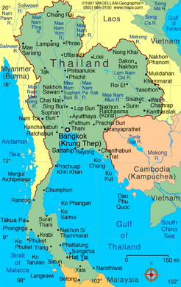
Groundwater contamination: Thailand
Phibun district
100 km² area affected
150,000 exposed individuals
Oxidation of disseminated arsenopyrite due to mining (Tin)
Range in As concentration was 1-5000 ug/L (ug/L = ppb)
On January 22, 2001 EPA adopted a new standard for arsenic in drinking water at 10 parts per billion (ppb), replacing the old standard of 50 ppb. The rule became effective on February 22, 2002. The date by which systems must comply with the new 10 ppb standard is January 23, 2006.
Smedley and Kinniburgh, 2002
IARC, 2004
Notes:
http://monographs.iarc.fr/ENG/Monographs/vol84/

Slide 25

Bangladesh
77 million people in Bangladesh have been exposed to contaminated ground water
http://www.slideshare.net/corytrimm/arsenic

Slide 26
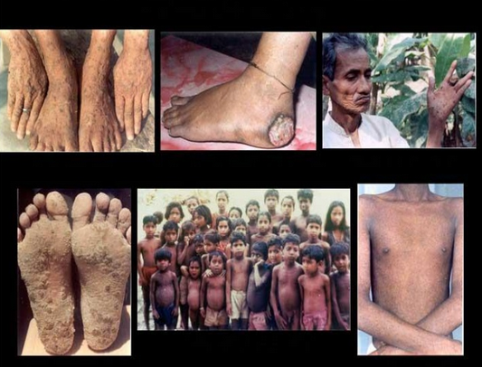
Notes:
http://www.slideshare.net/mayanksaxenaciv09/arsenic-contamination-of-groundwater?next_slideshow=2

Slide 27
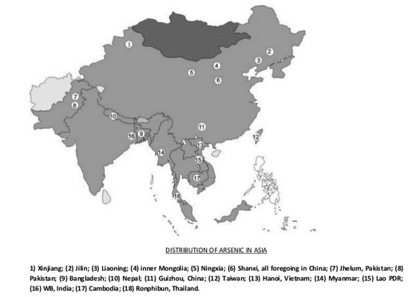
Notes:
http://www.slideshare.net/mayanksaxenaciv09/arsenic-contamination-of-groundwater?next_slideshow=2

Slide 28
Sources of Arsenic: Commercial Products
Wood preservative
Pesticides, herbicides and fungicides (residue of foods, tobacco)
Paints and pigments
Leaded gasoline

Slide 29
Patients at risk
Quantity of As released by human activities is 3X natural sources
Refinery workers
Farmers (pesticides, herbicides, fungicides)
Living near arsenic-emitting facilities
Living near mines ie. Tin mining (Thailand)
Areas of high geothermal activity
Ant poison ingestion by children – phase out recommended by EPA in 1989
‘Green wood’ – treated with copper arsenate
Drinking water contaminated with arsenic
Notes:
Green wood: treated with arsenic – used in marine applications, patio decks, recreational structures (playgrounds)

Slide 30
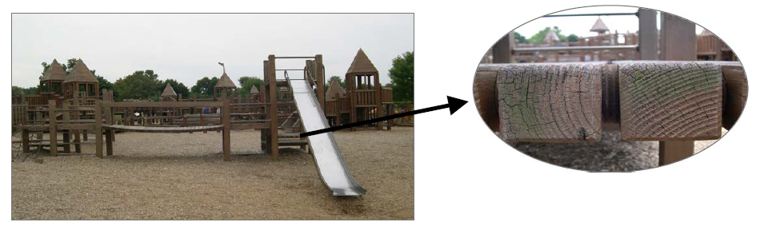
Notes:
CCA treated lumber = chromated copper arsenate – hand washing after contacting this wood is recommended

Slide 31
Human Exposure
Ingested: absorbed 60-90% from GI tract
Inhalation: also well absorbed
  In workplace: arsenic trioxide
  Small molecules can reach lower airways – autopsies of prior smelter workers show chronic lung arsenic particles
Dermal absorption: systemic toxicity may occur in rare occupational accidents where arsenic trichloride or arsenic acid is splashed on skin

Slide 32
Arsenic Clearance
Within two weeks of acute exposure: arsenic remains only in skin, hair, nails, bone and teeth
Fish arsenic is rapidly excreted in the urine with no toxicity
Arsenic is excreted primarily through the kidneys – blood levels can be normal, while urine levels may be very elevated

Slide 33
Quiz
What test would you like to order on your wood-worker patient?

Slide 34
Urine arsenic concentration
Spot urine: 6000 ug/L (normal < 100 ug/L)
Speciation may be performed in some labs: take organoarsenicals into account
Notes:
NHANES: National health and nutrition examination survey tested urine in representative sample of US population in 2003-4 – found 62.7% of elevated urine arsenic concentrations over 50 ug/L were due to organoarsenicals

Slide 35
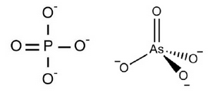
Pathophysiology of Arsenic Poisoning
Arsenic interferes with critical biochemical reactions by:
  Inhibition of sulfhydryl-containing enzymes
  Substituting for phosphate which causes hydrolysis of important phosphate bonds – ATP
Arsine gas: binds to RBCs, causing irreversible hemolysis

Slide 36
Gastrointestinal Effects
Increased permeability of GI blood vessels causes fluid loss
Inflammation and necrosis of GI tract can lead to hemorrhagic gastroenteritis
Tissue damage leads to hepatic necrosis: elevated LFTs
Acute RTA leads to proteinuria and elevated creatinine
Notes:
Minutes to hours after exposure: profound, often hemorrhagic gastroenteritis – may last a few days – requires symptomatic care

Slide 37
Cardiovascular Effects
Capillary leak – hypotension and shock
Myocardial damage and dysrhythmias: Wide QRS, long QT, ST segment changes
Vasospasm: ‘Blackfoot disease’ from contaminated water in Taiwan (10-1820 ppb)
Chile: Raynaud’s phenomenon and pediatric myocardial hypertrophy (20-400 ppb in drinking water)
Notes:
Death in acute arsenic exposure is from cardiovascular collapse
Vtach and V fib can occur acutely
-

Slide 38
Neurologic Effects
Peripheral neuropathy – due to destruction of axonal cylinders (axonopathy)
Acute testing may reveal features of acute inflammatory demyelinating polyneuropathy (Guillain-Barre)
Evolves into a classic sensorimotor distal axonopathy
Recovery can take years after cessation of exposure
Notes:
Onset of peripheral neuropathy may be several weeks after initial exposure
Typically begins as “pins and needles” in distal extremities (stocking-glove distribution) – usually mild distal weakness, although in very severe exposure can lead to profound, even respiratory weakness
-Evaluate with nerve conduction velocity testing

Slide 39
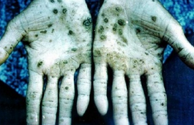
Dermal Effects
Characteristic palmoplantar hyperkeratosis with chronic exposure – may progress to malignancy (can take decades)
Hyperpigmentation: Eyelids, temples, axillae, neck, chest, groin
Occur with chronic exposure of over 400 ppb
Mees lines: visible several months after acute exposure, or a chronic finding in long-term exposure
http://www.slideshare.net/corytrimm/arsenic
Notes:
Aldrich Mees lines: pale bands on the nails – reflects transient disruption of nail growth during acute poisoning
-Skin lesions can be evaluated with biopsy to eval for skin cancer.
-hyperpigmentation usually precedes the hyperkeratosis
-Refer to dermatology for consideration of biopsy; retinoid therapy for hyperkeratotic/precancerous lesions

Slide 40
Respiratory Effects
Smelter and pesticide workers exposed to high concentrations of airborne arsenic: lung cancer in chronic exposure
Acute exposure: lung tissue irritation
Can occur with chronic arsenic dust exposure in work environments where arsenic concentrations are not regulated
Can occur with acute or chronic arsine gas exposure
Notes:
Cough, laryngitis, mild bronchitis, dyspnea
Nasal septal perforation and conjunctivitis have also been reported

Slide 41
Hematopoietic Effects
Acute and chronic exposures: reversible pancytopenia
Macrocytic anemia with basophilic stippling and mild eosinophilia
Notes:
Can also be accompanied by thrombocytopenia
Patients may require treatment with RBC transfusion, folate and iron

Slide 42
Carcinogenic Effects
Chronic ingestion: skin cancer
Possible association with lung, liver, bladder, kidney and colon CA
Likely due to arsenic’s effects on enzymatic processes involved in DNA repair
Bowen’s Disease: intraepidermal carcinoma, SCC, BCC
Notes:
Bowen’s disease: sharply demarcated, round or irregular plaques; tend to enlarge; range from 1mm to 10 cm. BCC (basal cell carcinoma) often occurs in multiple trunk lesions. SCC (squamous cell carcinomas) tend to occur on the extremities (palms and soles)

Slide 43
Lung Cancer
Risk with exposure to trivalent arsenicals (arsenic trioxide) in smelter workers and pentavalent arsenicals (pentavalent arsenical pesticides)
Notes:
No inc risk found with concomitant smoking or exposure to sulfur dioxide

Slide 44
Back to our first patient…
What findings in our first patient, the wood-worker, were suggestive of Arsenic exposure?
  Skin lesions: hyperpigmentation and hyperkeratosis
  Peripheral neuropathy: stocking glove distribution with pain sensory symptoms and no CNS abnormalities
  Mild macrocytic anemia
  Mildly elevated LFTs

Slide 45
Time Course
How long does it take after an initial arsenic exposure to develop pigmentation changes and keratosis?
How long does it take to develop skin cancer?
Notes:
Hyperpigmentation and skin keratosis may take 3-7 years to appear; skin cancer may take decades (up to 40 years)

Slide 46
Management of Acute Arsenic Poisoning
Fluid resuscitation and electrolyte replacement
Hemodialysis may be needed for renal failure
Historical approach: IM BAL (British anit-Lewisite or 2,3-dimercaptopropanol or Dimercaprol: 3-5 mg/kg Q 4h X 2 days, Q6h on day 3 then Q12 h X 10 days
Current approach: DMSA or DMPS
Use of oral DMSA (2,3 – dimercaptosuccinic acid) limited by GI symptoms
DMPS (2,3-dimercapto1-propanesulfonate)
Notes:
Exchange transfusion can be performed in cases of massive hemolysis

Slide 47
Management of Chronic Arsenic Poisoning
Prevent further exposure
Available evidence does not support chelation therapy for peripheral neuropathy
24 hour urine Arsenic > 35 ug/L should have consideration for early workplace intervention to limit ongoing exposure
Vitamin A analogs (retinoids) may be used for pre-cancerous arsenical keratosis
Maximize nutritional status: ensuring adequate dietary selenium can improve methylation and therefore excretion of arsenic
Encourage antioxidant and folate ingestion

Slide 48
Standards & Regulations
The US Environmental Protection Agency recommends maximum ingestion of 0.3ug/kg/day
The 95% of inorganic arsenic concentrations from US NHANES data is below this concentration
OSHA: 5 ug/m3 for at least 30 days per year mandates medical evaluation
https://www.osha.gov/SLTC/arsenic/index.html

Slide 49
Preventive Care
Smoking cessation
Avoiding excessive sun light exposure: As + UVB
Elevated urine arsenic concentration with patient exposed to groundwater – consider contacting authorities for investigation
http://www.atsdr.cdc.gov/cabs/arsenic/index.html

Slide 50
Quiz
Which of the following laboratory tests can be abnormal in arsenic toxicity:
  Urine B12 concentration
  Liver Function Tests
  Amylase
  Waxy casts in urine
Notes:
LFTs

Slide 51
Quiz
Which of the following hematologic abnormalities can be seen with arsenic poisoning?
  Eosinophilia
  Macrocytic anemia
  Basophilic stippling
  Thrombocytopenia
  All of the above
Notes:
All of the above

Slide 52
Quiz
What is the primary cause of death in acute arsenic poisoning
  Central nervous system depression
  Status epilepticus
  Cardiovascular collapse and shock
  Hemorrhage
Notes:
Cardiovascular collapse and shock

Slide 53
Quiz
Which of the following findings can be seen in chronic arsenic exposure?
  Peripheral neuropathy
  Mees lines
  Hyperkeratosis
  Hyperpigmentation
  All of the above
Notes:
All of the above

Slide 54
Review
Chronic arsenic toxicity
Skin lesions
Peripheral neuropathy
Anemia
Acute arsenic toxicity
Hemolytic anemia
Difficulty breathing
Shock

